Slide 1


Asha M. Tarsadia Institute of Computer Science and Technology
Computer Science and Engineering
Diamond Price Predictor
Prepared by
Patel Nidhi Jigneshkumar
(202303103510358)
Guided by
PROF. URVISHA PATEL

Slide 2
Outline
Client Profile
Project Introduction
Objective(s)
Problem Analysis
Requirement Engineering
Software Development Model
Modeling
Others

Slide 3
Client Profile
Company name: Dev Diamond jewellery
Client name: Mr. Jigneshkumar Patel
Address: Shop no.-34 Diamond arcade, 3rd floor,
near mini bazar, Varachha, Surat
Your communication: communicate in two meeting

Slide 4
Project Introduction
Basically, It’s a Web page, Who Predict Price of Diamond with help of some basic feature of diamond.
Here, the Client have to enter Diamond information such as diamond manufacture place, Shape, Carat, Clarity, Color and by clicking on price calculation Button. It will predict the accurate price of diamond.

Slide 5
Objective(s)
The objective of this Web page is to predict accurate price of Diamond that is going to be used in making Diamond jewellery.
So that, with the help of this predict price client can assume, Estimated costing of jewellery and at any instance of time and tell to customer.
So, the customer can choice diamond jewellery according, to there budget and choices

Slide 6
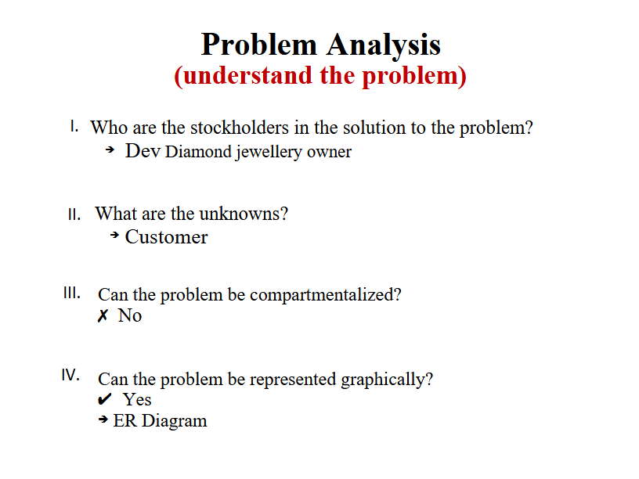
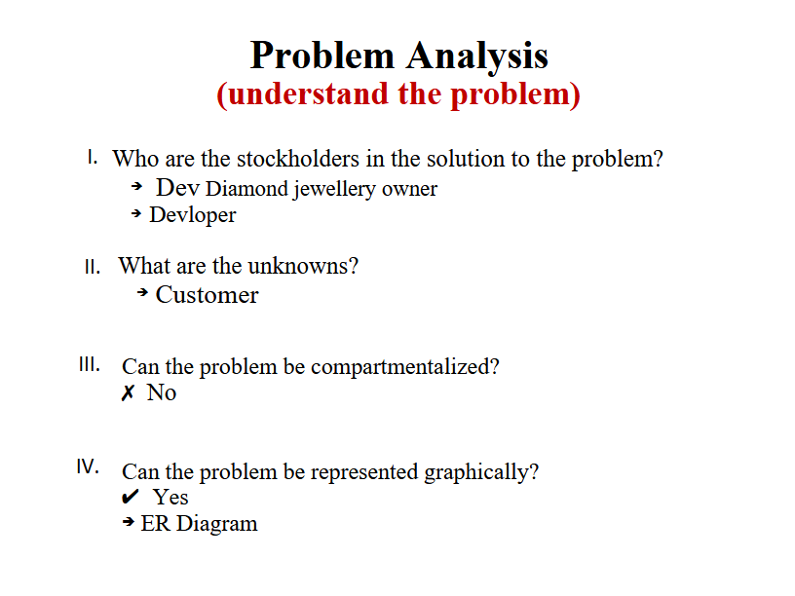
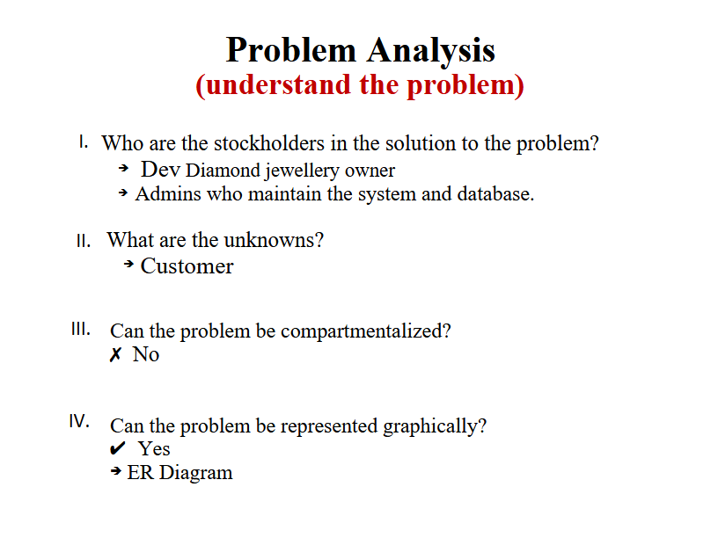
Problem Analysis (Understand the problem)
Who are the stockholders in the solution to the problem?
Dev Diamond jewellery owner
What are the unknowns?
Customer
Can the problem be compartmentalized?
No

Slide 7
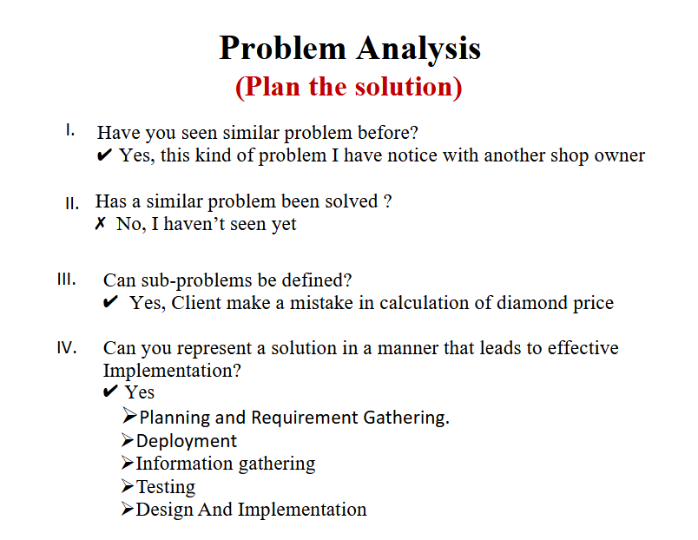

Slide 8
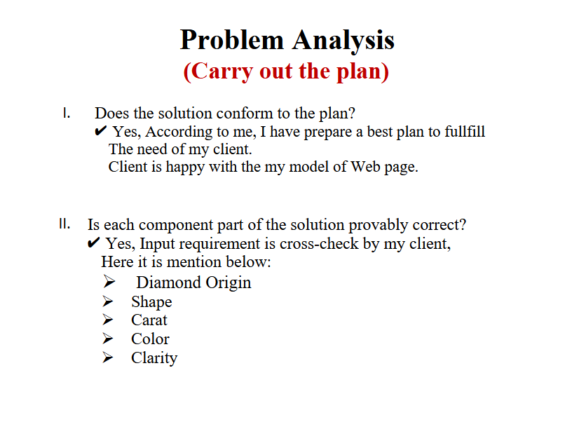

Slide 9
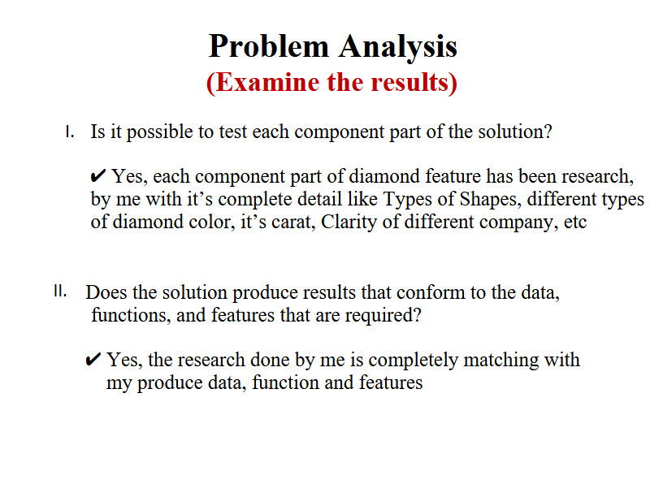

Slide 10
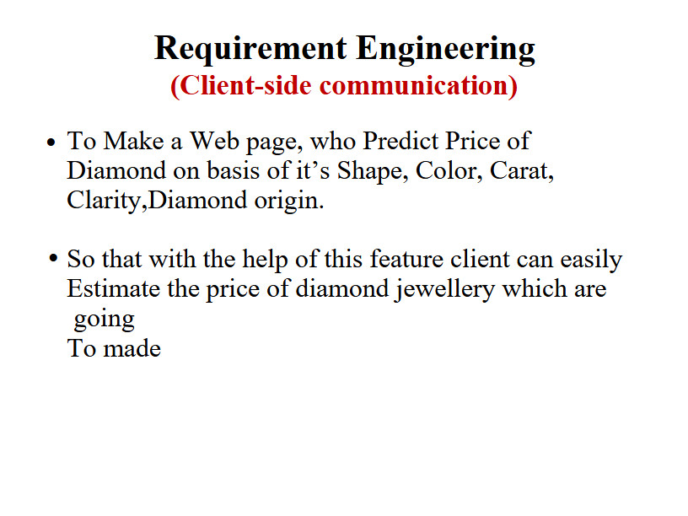
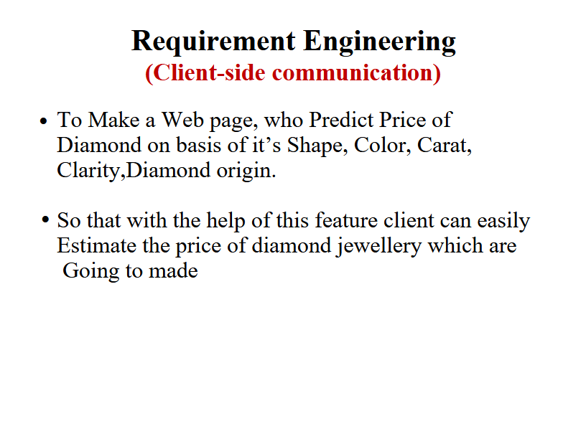
Requirement Engineering (Client-side communication)
To Make a Web page, who Predict Price of Diamond on basis of it’s Shape, Color, Carat, Clarity,
Diamond origin.
So that with the help of this feature client can easily
Estimate the price of diamond jewellery which are
going to made

Slide 11
Requirement Engineering (Functional Requirements)
FR | Client Requirements
Description | Only user need to open web page.
Actor(s) | Client
Input(s) | Client have to enter Diamond detail such as: Diamond origin, Shapes, Carat, Color, Clarity.
Output(s) | Estimated Price of Diamond.

Slide 12
Software Development Model (Agile Model)
Agile Development Model
Agile is ideal for projects like a diamond price calculator because it allows flexibility, iterative progress, and frequent feedback. Since your project might involve changes in design, user experience, and adjustments to features based on client feedback, the Agile model provides continuous improvement

Slide 13
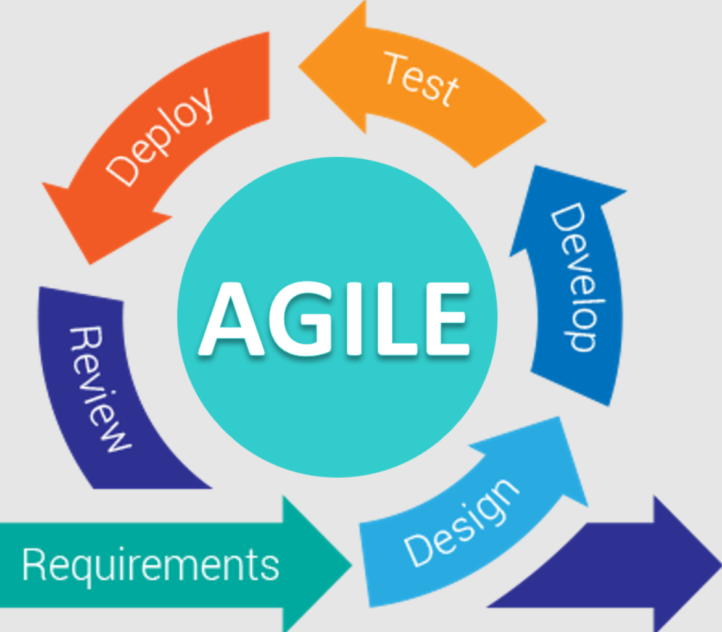
Agile model:

Slide 14
Modelling (Developing the use cases)
I. Who are the primary and secondary actors?
Primary Actor: Customer of Jewellery shop
Secondary Actors:
Dev Diamond Jewellery staff
Admins who maintain the system and database.
II. What are the actor’s goal(s)?
Customer's Goals: Easily determine the price of a diamond based on the selected shape, carat, color, and clarity.
Gain transparency in pricing and be able to compare options.
Admin’s Goals: Manage and update pricing algorithms and the catalog of diamond options.

Slide 15
III. What preconditions should exist before the story begins?
A database with up-to-date diamond prices, shapes, colors, and clarity details.
The system backend is properly linked to the front-end form.
IV. What main tasks or functions are performed by the actor?
Customer Tasks:
Select diamond specifications (shape, carat, color, clarity).
Click “Calculate” to view the price.
Admin Tasks:
Update diamond prices or characteristics in the backend.
Ensure the website and database are functioning correctly.

Slide 16
V. What exceptions might be considered as the story is described?
System Exceptions:
The database for prices or diamond options is down.
Invalid input (e.g., negative carat value or a non-existing diamond type).
User Exceptions:
Users selecting incompatible diamond specifications.
Network issues while accessing the system.
VI. What variations in the actor’s interaction are possible?
Customers can change selections (shape, carat, color, clarity) and recalculate the price.
Admins can modify diamond prices or add/remove diamonds from the inventory.
VII. What system information will the actor acquire, produce, or change?
Customer: Receives the diamond price based on their selected options.
Admin: Updates or adjusts the pricing system, adding or removing data regarding diamonds.

Slide 17
VIII. Will the actor have to inform the system about changes in the external environment?
Admin: Yes, the admin will need to update prices based on market changes or new diamond stock availability.
Customer: No, they only use the tool to get results.
IX. What information does the actor desire from the system?
Customer: Accurate diamond price based on the selected specifications.
Admin: Clear analytics on pricing changes and diamond selection trends.
X. Does the actor wish to be informed about unexpected changes?
Customer: Yes, if there are updates to prices or availability during their interaction (e.g., if the price is temporarily unavailable).
Admin: Yes, admins need alerts on system issues or database failures to maintain uptime.

Slide 18
Modelling (Use cases)
Calculating Diamond Price
Primary Actor(s) | Client
Goal of the use case | To calculate the price of a diamond based on its cut, carat, clarity, and color.
Precondition | The user has information about the diamond they wish to price (cut, carat, clarity, and color).
Trigger | The user wants to know the price of a diamond based on their selected attributes.

Slide 19
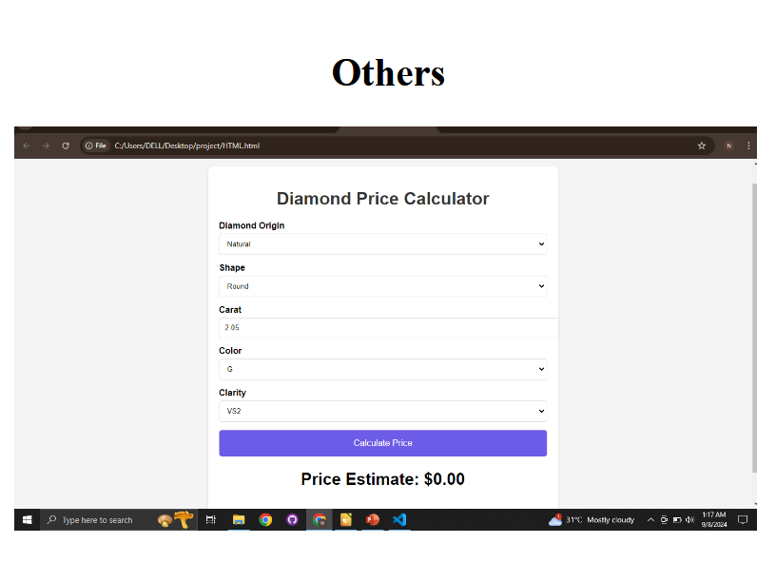
Others
<You can add any other content you found necessary for your project and want to present>
<You can add screen shots of development, if started>

